Slide 1
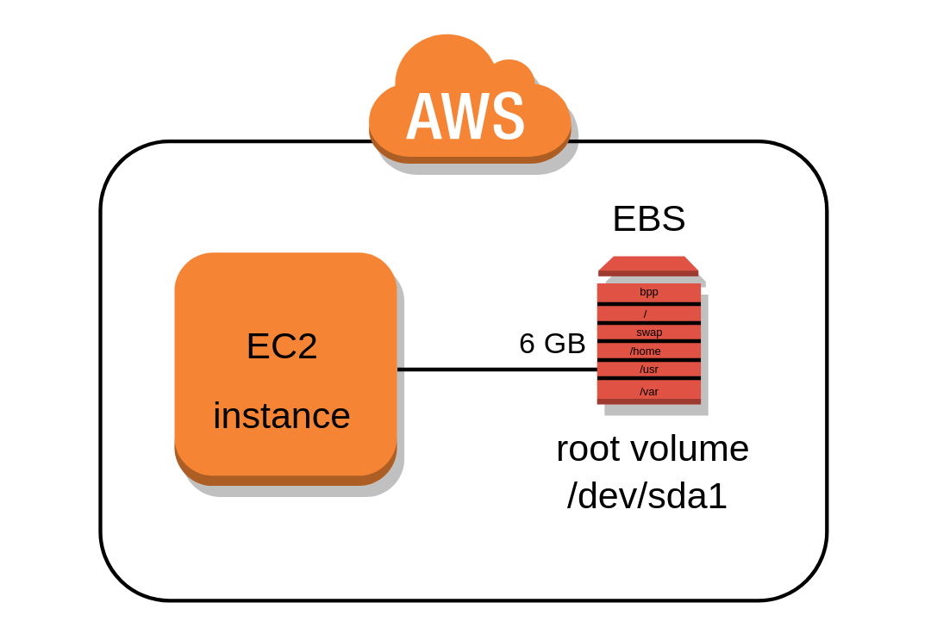
EBS

Slide 2
Amazon EBS is an abbreviation of “Amazon Elastic Block Storage”. As most of the services of AWS.
Amazon EBS is also an elastic service. Amazon EBS provides an elastic, high performance, low-latency persistent block storage in AWS cloud.
An Amazon EBS volume is an unformatted, raw, external block device that you can attach to a single instance. When we say instance that means Amazon EC2 instance. You can dynamically change or add the volume to your running EC2 instance.
AWS also provides encryption features. Amazon EBS volumes can be created as encrypted with the encryption features. Also, You can take backups of your EBS volumes by creating the snapshots.

Slide 3
• An EC2 machine loses its root volume (main drive) when it is manually terminated.
• Unexpected terminations might happen from time to time (AWS would email you)
• Sometimes, you need a way to store your instance data somewhere
• An EBS (Elastic Block Store) Volume is a network drive you can attach to your instances while they run
• It allows your instances to persist data

Slide 4
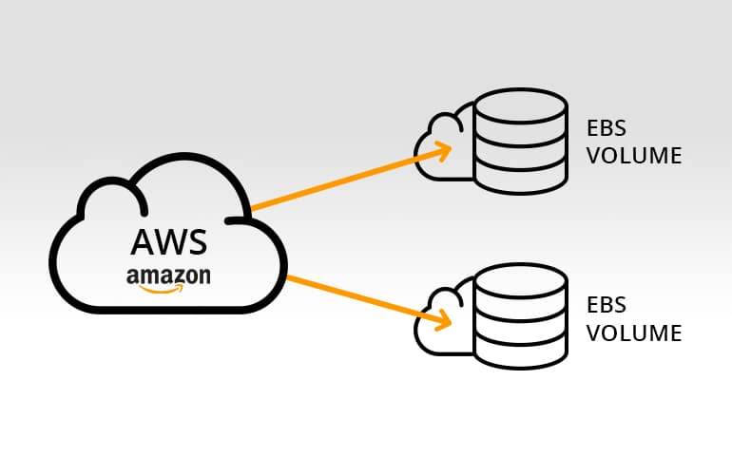
EBS VOLUME

Slide 5
EBS Volume
AWS EBS volumes are the block-level storage devices which provide high durability. You can attach the EBS volume to a single EC2 instance at a time.
These are primary storage devices which can be used for frequent updates.
It’s a network drive (i.e. not a physical drive) , It uses the network to communicate the instance, which means there might be a bit of latency
Once the EBS volume is attached to your instance, you can use them just like any other physical hard drive.
It can be detached from an EC2 instance and attached to another one quickly
It’s locked to an Availability Zone (AZ)
An EBS Volume in us-east-1a cannot be attached to us-east-1b • To move a volume across, you first need to snapshot it .

Slide 6
Why Amazon EBS?
AWS provides countless benefits :
1. Consistent with Low-Latency Performance
Amazon EBS general purpose (SSD) volumes provide very consistent performance with very low-latency. I/O performance is consistent and can be scaled to the needs of your application.
2. Backup & Restore
To protect your data, you can take backups by taking the snapshot at any point-in-time. The best thing is that AWS stores the snapshot incrementally. That means it only stores the data which has been changed from the last snapshot. This reduces the usage cost as well.
You can use the snapshots for backup purposes. Backup and restore of Amazon EBS are very fast and reliable.
3. Reliable
Amazon EBS is highly reliable as it replicates the volume in the availability zone. This protects from the component failure.
4. Secure Storage
AWS provides encryption feature to encrypt the EBS volumes to make them more secure. EBS encryption and access control policies deliver a strong defense-in-depth security strategy for your data.
5. Optimized Performance
Amazon EBS provides the best possible performance for your EBS volumes by minimizing the network connection between EC2 instance and EBS itself. Optimized instances provide optimized network capacity for your volumes.
6. Scalability
We keep saying that most of AWS services are highly scalable so the Amazon EBS. AWS provides you ability to optimize your volume in terms of performance, capacity, and cost. You can scale up and down EBS volumes at any point-in-time.

Slide 7
EBS VOLUME TYPES
Amazon EBS provides the following volume types:
General Purpose SSD (gp2)
Provisioned IOPS SSD (io1)
Cold HDD (sc1)
Throughput Optimized HDD (st1)

Slide 8
EBS Volumes Types
EBS Volumes come in 4 types
GP2 (SSD): General purpose SSD volume that balances price and performance for a wide variety of workloads
IO1 (SSD): Highest-performance SSD volume for mission-critical low-latency or high- throughput workloads
ST1 (HDD): Low cost HDD volume designed for frequently accessed, throughput- intensive workloads
SC1 (HDD): Lowest cost HDD volume designed for less frequently accessed workloads
“EBS Volumes are characterized in Size | Throughput | IOPS (I/O Ops Per Sec) .s Only GP2 and IO1 can be used as boot volumes”

Slide 9
1. Solid-State Drives (SSD)
The devices backed with Solid-State Devices (SSD) is optimized for the transactional workload. Where you need very frequent read and write operation with small size I/O. The performance attribute here is IOPS (I/O operations per second).
2. Hard Disk Drives (HDD)
The devices backed with Hard Disk Drives (HDD) are optimized for heavy streaming workloads. The performance measurement is in MiB/s (megabyte per second) which is a lot better than IOPS.

Slide 10
EBS –Volume Types Summary
1.gp2: General Purpose Volumes (cheap)
3 IOPS / GiB, minimum 100 IOPS, burst to 3000 IOPS, max 16000 IOPS
1 GiB – 16 TiB , +1 TB = +3000 IOPS
2. io1: Provisioned IOPS (expensive)
Min 100 IOPS, Max 64000 IOPS (Nitro) or 32000 (other)
4 GiB - 16 TiB. Size of volume and IOPS are independent
3. st1: Throughput Optimized HDD
500 GiB – 16 TiB , 500 MiB /s throughput
4. sc1: Cold HDD, Infrequently accessed data
500 GiB – 16 TiB , 250 MiB /s throughput

Slide 11
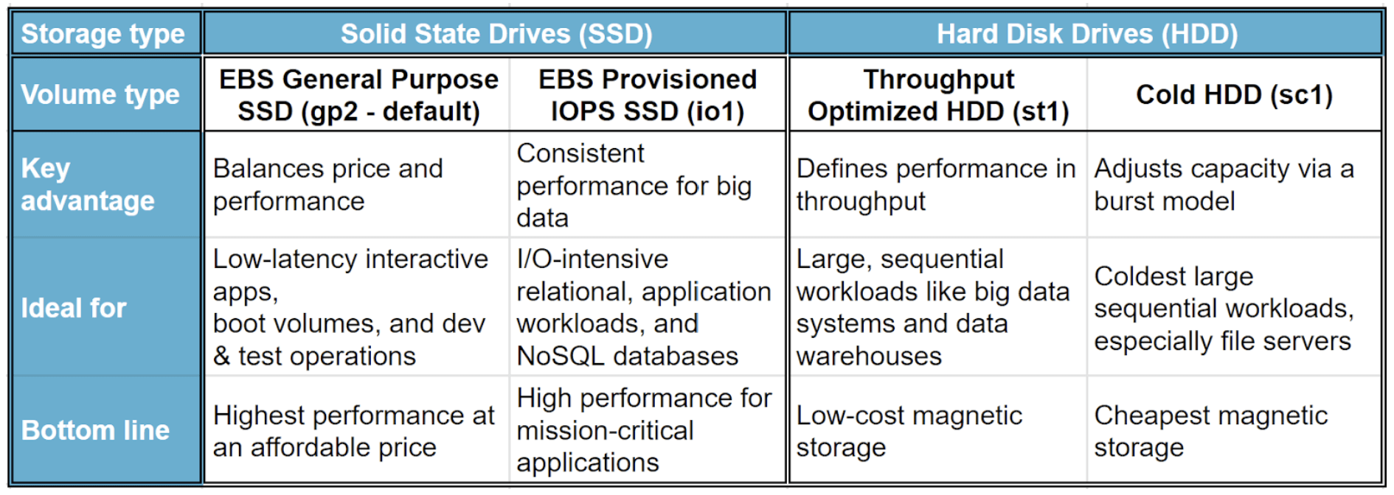

Slide 12
EBS snapshot
An EBS snapshot is a point-in-time, incremental backup of your EBS volume.
They can be used for individual volumes, or across multiple volumes within the same region, allowing you to back up large databases or file systems.
When you create an EBS volume based on a snapshot, the new volume begins as an exact replica of the original volume that was used to create the snapshot.
You can share a snapshot across AWS accounts by modifying its access permissions. You can make copies of your own snapshots as well as snapshots that have been shared with you

Slide 13
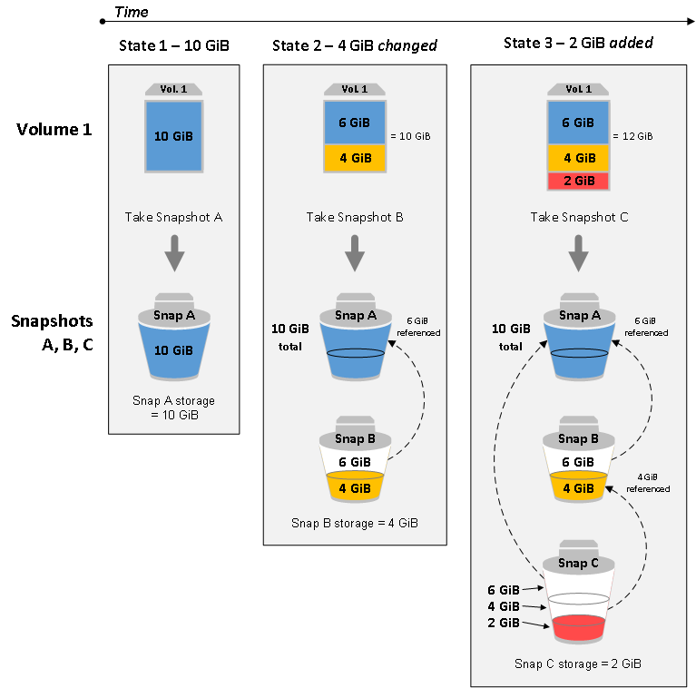

Slide 14


Slide 15
Amazon Elastic File System
Amazon Elastic File System (Amazon EFS) provides a simple, scalable, fully managed elastic NFS file system for use with AWS Cloud services and on-premises resources.
Amazon EFS is designed to provide massively parallel shared access to thousands of Amazon EC2 instances, enabling your applications to achieve high levels of aggregate throughput and IOPS with consistent low latencies.
Amazon EFS is a regional service storing data within and across multiple Availability Zones (AZs) for high availability and durability. Amazon EC2 instances can access your file system across AZs, regions, and VPCs

Slide 16
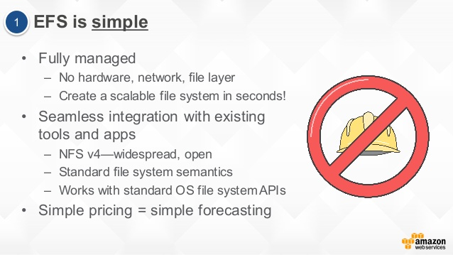

Slide 17
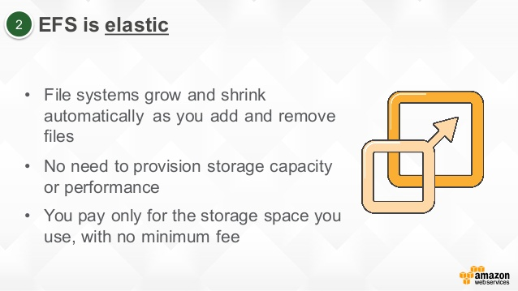

Slide 18
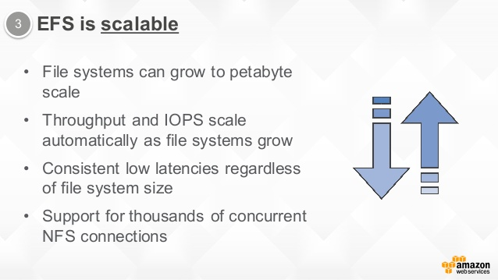

Slide 19
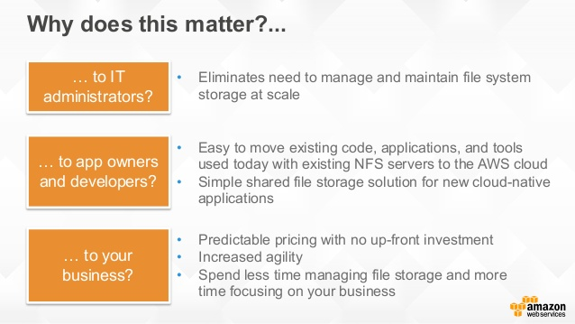

Slide 20
EBS vs Instance Store
Some instance do not come with Root EBS volumes
Instead, they come with “Instance Store”
Instance store is physically attached to the machine (EBS is a network drive)
Pros:
Better I/O performance (EBS gp2 has an max IOPS of 16000, io1 of 64000)
Good for buffer / cache / scratch data / temporary content
Data survives reboots
Cons:
On stop or termination, the instance store is lost
You can’t resize the instance store
Backups must be operated by the user

Slide 21
QUIZ

